Slide 1
Using Machine Learning to Predict New York City Agency Response Times
Mariia Aleksandrovych and Rebecca Heilweil

Slide 2
City agencies vary sharpy in response times
911 calls are (ideally) answered relatively quickly. But 311 calls, which might be used to address everything from illegal parking and heat issues to abandoned cars, don’t necessarily have the same sort of reliability.
Our project aims to evaluate which machine learning based systems might be best suited toward predicting how long city agencies take to respond to calls from constituents. Ultimately, we create a model that predicts how fast your issue might get resolved by the city. Our system outperforms linear regression.

Slide 3
Why does this matter
We are interested in providing a view into the efficacy of New York City agencies. Understanding how fast an agency might respond to an issue can help inform people, in real time, about how reliable the city might be.
This research might also give us insight into whether the city is serving some locations, or certain types of complaints, more quickly than others.
We might find errors in the data to inform city officials — we actually did find potential errors!

Slide 4
Our data: New York’s Open Data repository
As part of the NYC Open Data initiative, New York City has been collecting data on 311 response times since 2010.
Updated daily, this database includes more than 35 million requests that have been called into 311 — ensuring there is plenty of data available for testing, training, and validation.
Features include location, the type of complaint, the responding agency, a description of the complaint, borough.
This data is produced automatically.
We worked with about 500,000 samples.

Slide 5
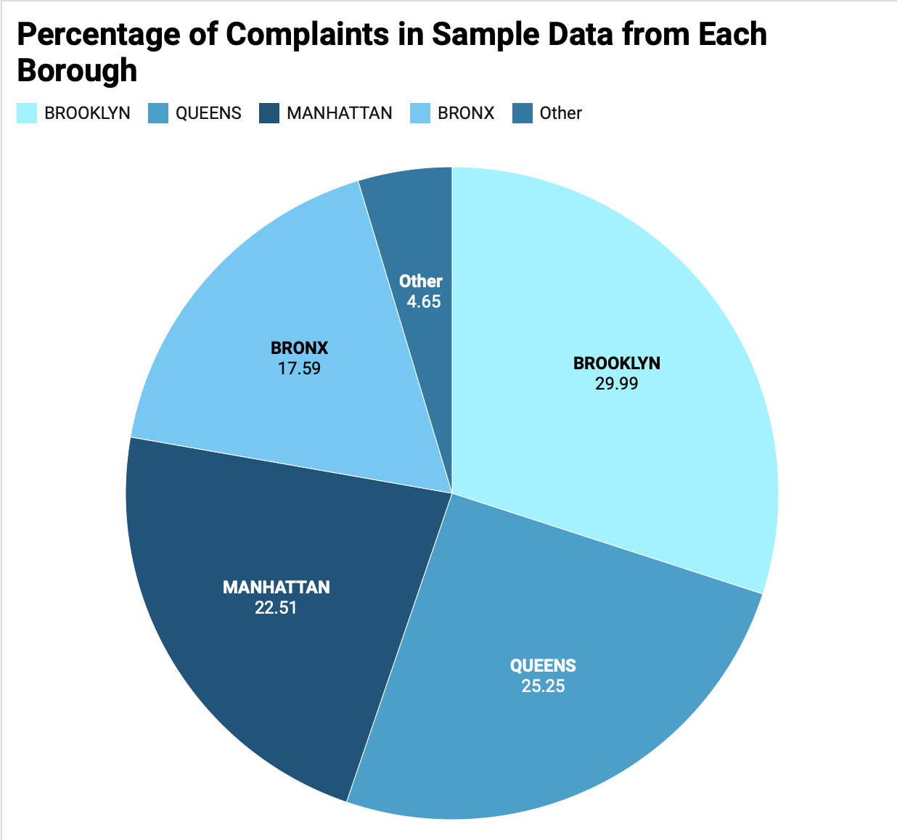

Slide 6
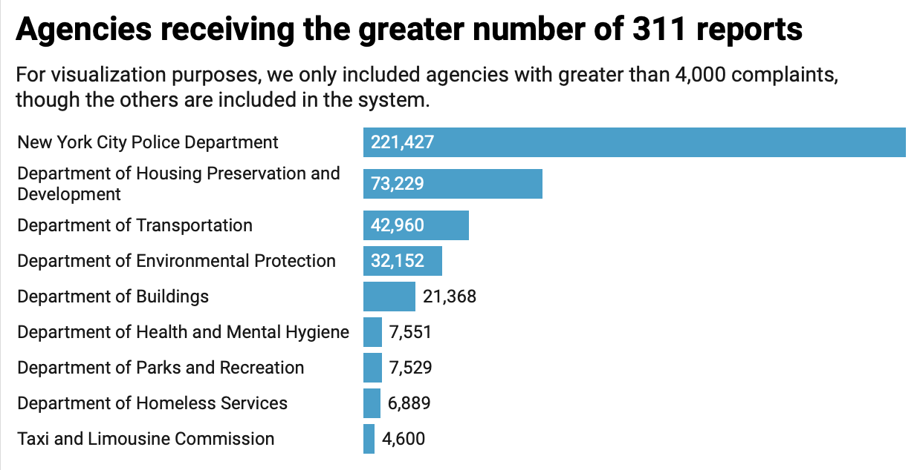

Slide 7
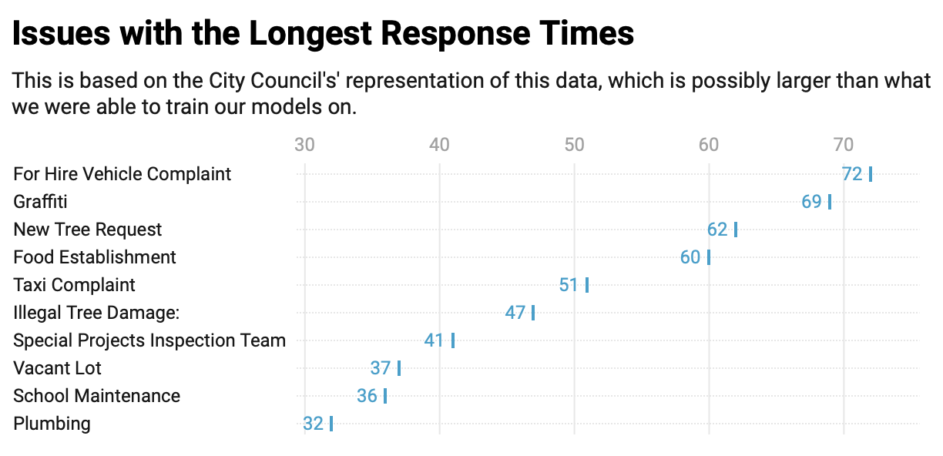

Slide 8
Feature selection
There were about 40 options for features. Many of these features were redundant (for instance, there were multiple cells for longitude and latitude, as well as two different columns representing the city agency responding).
Some of these features were almost always null because they only applied to very specific circumstances (like 311 requests that involved a taxi service).
We also remove a call ID number, since that number was essentially meaningless.
We converted two dates, the date a complaint was created and the date it was resolved, into a new metric: hours passed between complaint created and resolved.

Slide 9
Error in NYC Open Data
While completing our research, we discovered that at least 2,000 — we are working with sample data, so the real number may be higher — reports filed by or about the Department of Transportation have errors.
We discovered this issue because we created a “Time Elapsed” feature from a “Created” and “Resolve” data feature — and realize we were getting theoretically impossible negative time elapsed values.
We decided to drop any scenario in which this happened, but future research could involve alerting NYC DOT of the issue and investigating.

Slide 10
Baseline models, based on MSE
We evaluate three primary baselines:
Baseline Mean Squared Error, calculated directly from the dataset. ~32006
MSE using a Lasso Regression: ~29034
MSE using Linear Regression ~29028

Slide 11
First Model: Gradient Boosted Tree Regression
Using default parameters, we achieve an MSE of ~16000, noticeably outperforming out baselines.
We also saw that agency was highlight related to the response time, which we measured in hours, followed by complaint type, descriptor, and then location type.
Interestingly, Borough, Longitude, and Latitude did not provide significant importance to the model

Slide 12
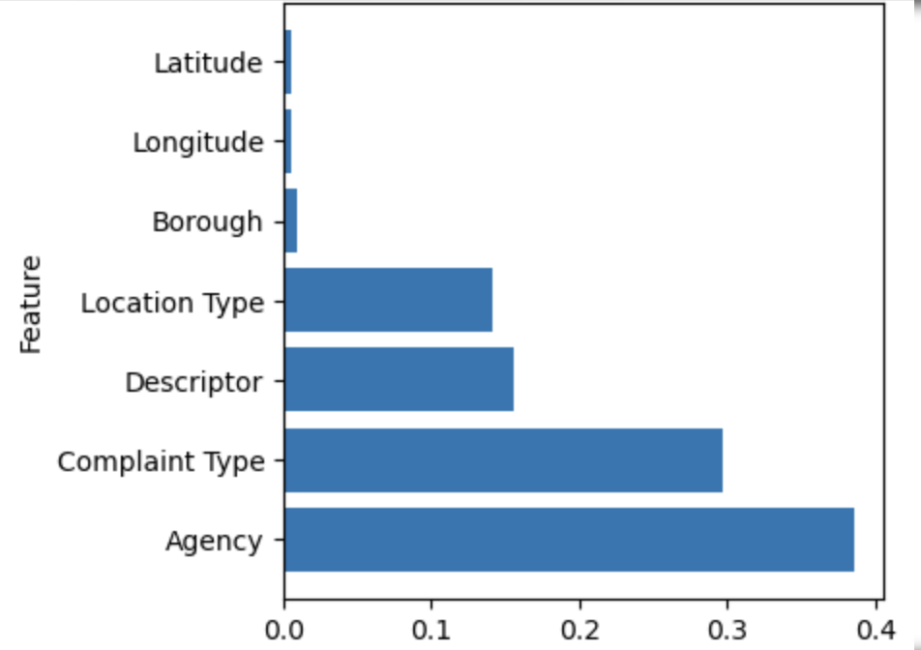
First Model: Features Importance

Slide 13
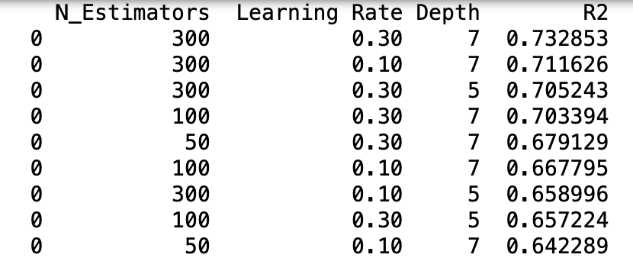
Hyperparameter Tuning for GBT Regressor

Slide 14
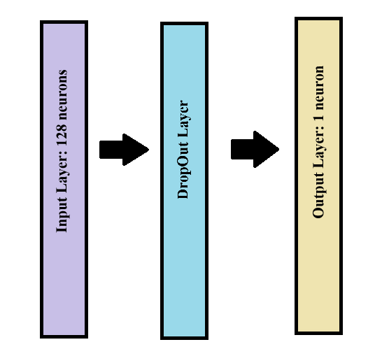
Second Model: Neural Network
Architecture.
Input layer: fully connected 128 neurons, ReLU activation, L2 regularization, and input shape ( , 7) i.e. seven features.
DropOut Layer: Drops 20% of the passed data.
Output Layer: Single neuron, Linear activation
Training
Optimizer: Adam
Learning Rate: 0.001 for 10 epochs after 10 epochs we have exponential decay: Learning Rate(epoch)=0.001×exp( 0.1×(10−epoch))
Batch size: 32
Validation split: 80% training, 20% validation
Loss Function: Mean Squared Error
#N: ~11k

Slide 15
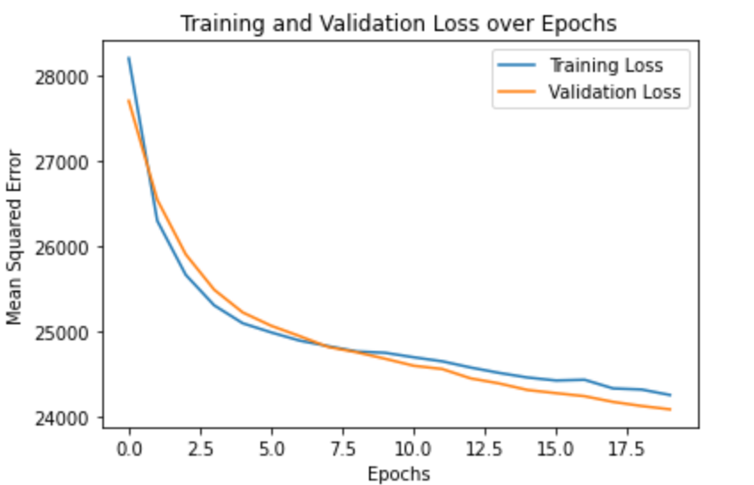
Second Model: Neural Network
Performance:
Mean Squared Error on the training data set: 23,253
Mean Squared Error 5 fold cross-validation: 20,861 +/- 600
Mean Squared Error on out of sample set (~10,000): 65,427
Baseline (mean): 71,167 Baseline (Linear regression): 66,329

Slide 16
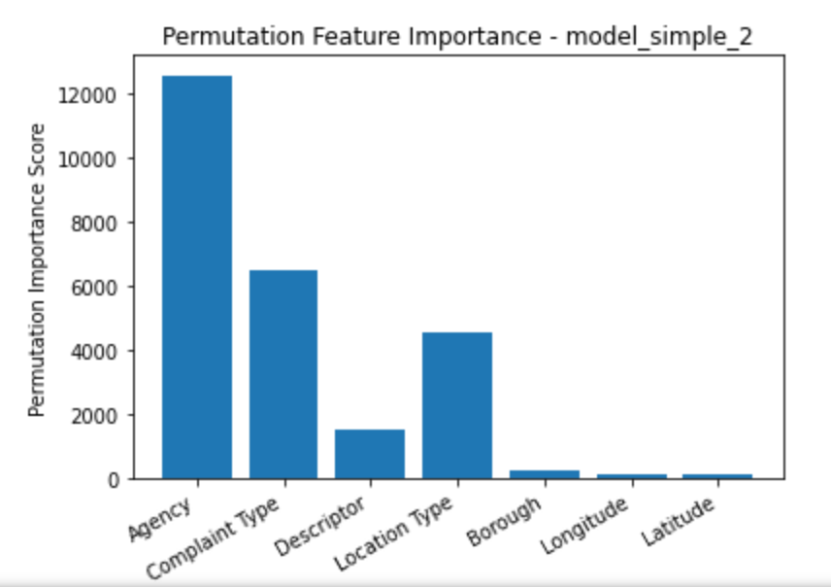
Second Model: Features Importance (Permutations)

Slide 17
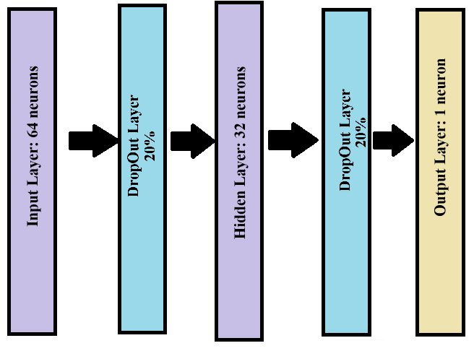
Third Model: 2 Layers Neural Network
Architecture.
Input layer: fully connected 64 neurons, ReLU activation, L2 regularization, and input shape ( , 7) i.e. seven features.
DropOut Layer: Drops 20% of the passed data.
Hidden Layer: fully connected 32 neurons, ReLU activation, L2 regularization, and input shape ( , 7) i.e. seven features.
DropOut Layer: Drops 20% of the passed data.
Output Layer: Single neuron, Linear activation
Training
Optimizer: Adam
Learning Rate: 0.001 for 10 epochs after 10 epochs we have exponential decay: Learning Rate(epoch)=0.001×exp( 0.1×(10−epoch))
Batch size: 32
Validation split: 80% training, 20% validation
Loss Function: Mean Squared Error
#N: ~29k

Slide 18
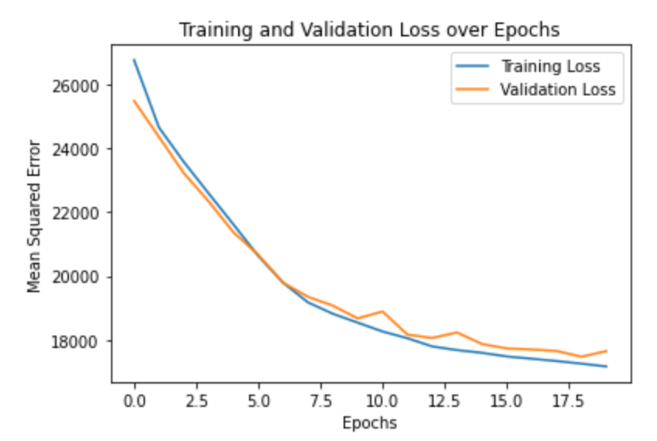
Third Model: 2 Layers Neural Network
Performance:
Mean Squared Error on the training data set: 16,870
Mean Squared Error 5 fold cross-validation: 16,587 +/- 873
Mean Squared Error on out of sample set (~10,000): 67,353
Baseline (mean): 71,167 Baseline (Linear regression): 66,329

Slide 19
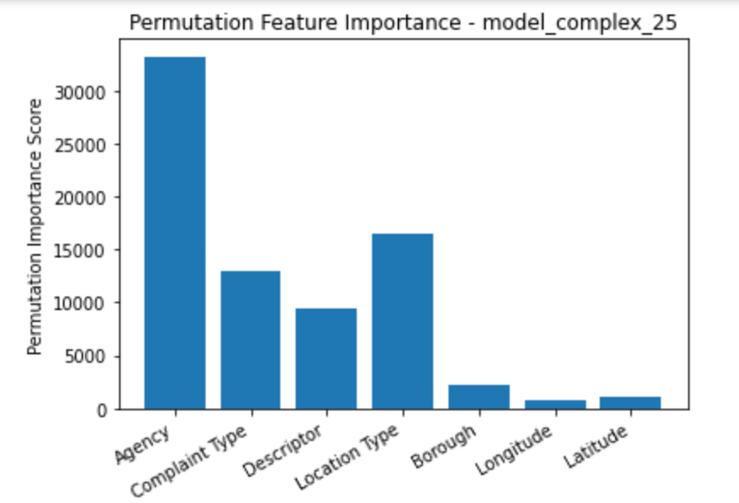
Third Model: Features Importance (Permutations)

Slide 20
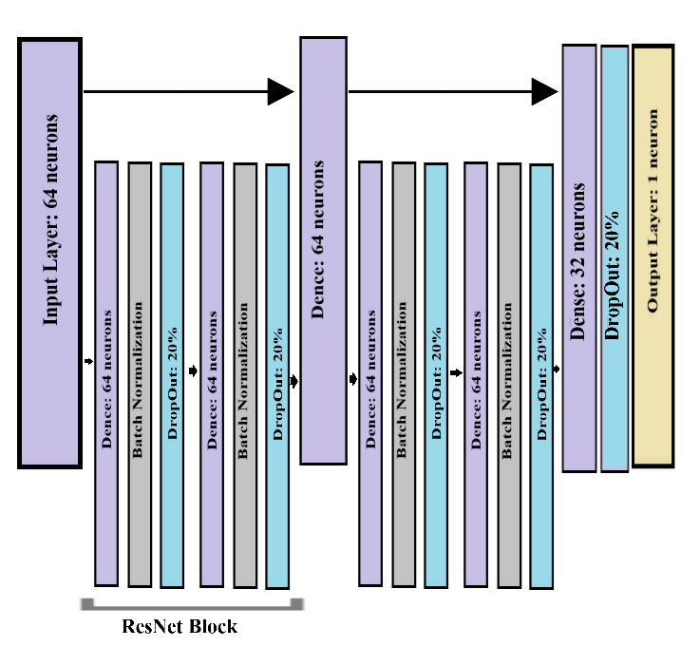
Fourth Model: Deep ResNet
Architecture.
Input layer: fully connected 64 neurons, ReLU activation, L2 regularization, and input shape ( , 7) i.e. seven features.
Residual Block: 2 Dense layer (64 neurons, ReLU activation, L2 regularization) following with Batch Normalization, and Dropout (20%) Layers
Dense: fully connected 64 neurons, ReLU activation, L2 regularization
Second Residual Block: 2 Dense layer (64 neurons, ReLU activation, L2 regularization) following with Batch Normalization, and Dropout (20%) Layers.
Dense: fully connected 32 neurons, ReLU activation, L2 regularization
DropOut Layer: Drops 20% of the passed data.
Output Layer: Single neuron, Linear activation
Training
Optimizer: Adam
Learning Rate: 0.001 for 10 epochs after 10 epochs we have exponential decay: Learning Rate(epoch)=0.001×exp( 0.1×(10−epoch))
Batch size: 32
Validation split: 80% training, 20% validation
Loss Function: Mean Squared Error
~#N: ~47k

Slide 21
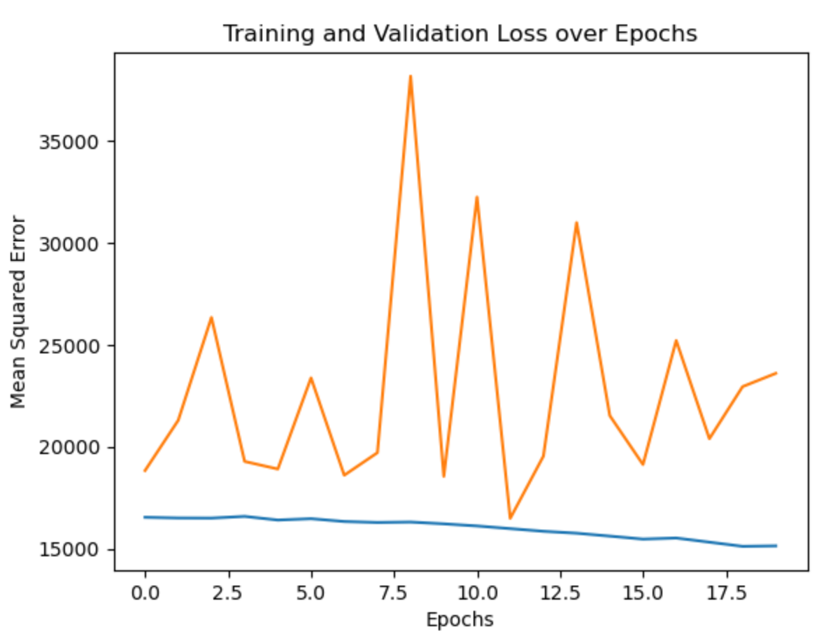
Fourth Model: Deep ResNet
Performance:
Mean Squared Error on the training data set: 17,900
Mean Squared Error 5 fold cross-validation: 19,422 +/- 3,547
Mean Squared Error on out of sample set (~10,000): 84,365
Baseline (mean): 71,167 Baseline (Linear regression): 66,329

Slide 22
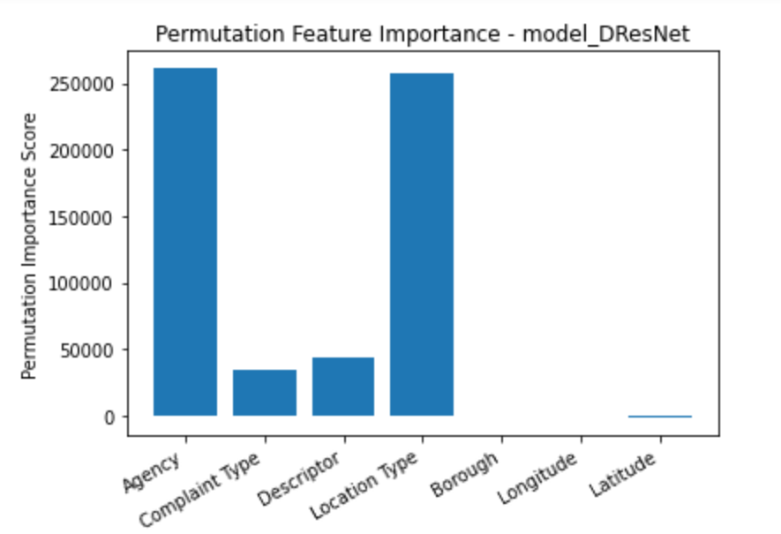
Fourth Model: Deep ResNet

Slide 23
5 fold Cross-Validation (MSE)
Linear Regression - MSE: 28904.17261398608 +/- 346.5560153708919
Lasso Regression - MSE: 28918.12591391247 +/- 343.8195874035514
GB Regression - MSE: 4985.333993772696 +/- 86.11027934727582
Simple 1 layers NN- MSE: 20861.137890625 +/- 600.5459880750432
2 layers NN - MSE: 16587.6294921875 +/- 381.237108979759
3 layers DResNet - MSE: 59389.391796875 +/- 84009.95419371294

Slide 24
Out-of-sample comparative performance (MSE)
MSE for Baseline Model: 71167.0791123987 MSE for Linear Regression Model: 66329.90822792749 MSE for Lasso Model: 66449.24024717495 MSE for GBT Model: 64077.68799608705 MSE for NN 1 layers Model: 63790.3143967668 MSE for NN 2 layers Model: 65652.52003491706 MSE for DResNet 3 layers Model: 84365.82704451475 *We ran this several times and got different results, but the GBT and 1-layer NN always tended to outperform the others. The file size is too big to effectively shuffle.

Slide 25
Reflections:
It makes sense that this system performed far better on tabular data — we know that neural networks don’t necessarily perform well.
It’s interesting that agency has such a high impact on 311 call response rate, but, perhaps more importantly, location is not a primary driver of response times using most models.
The model is probably useful for determining if 311 will fix your issue in a few hours, half a day, or several days — but can’t necessarily give you an hour-by-hour prediction.
It’s interesting we got one neural network to perform basically as well as a Gradient Boosted Tree regressor!

